Slide 1

Python 101
Notes:
Update 2024-12-27

Slide 2
Plan
Install Python
First steps
Datatypes
Loops, Conditions, Functions
Manage Packages
Development environments: Jupyter & VS Code
File system
Advanced dev stuffs: Virtual environments, Unit testing, …

Slide 3

xkcd.com/353/
Notes:
https://xkcd.com/353/

Slide 4
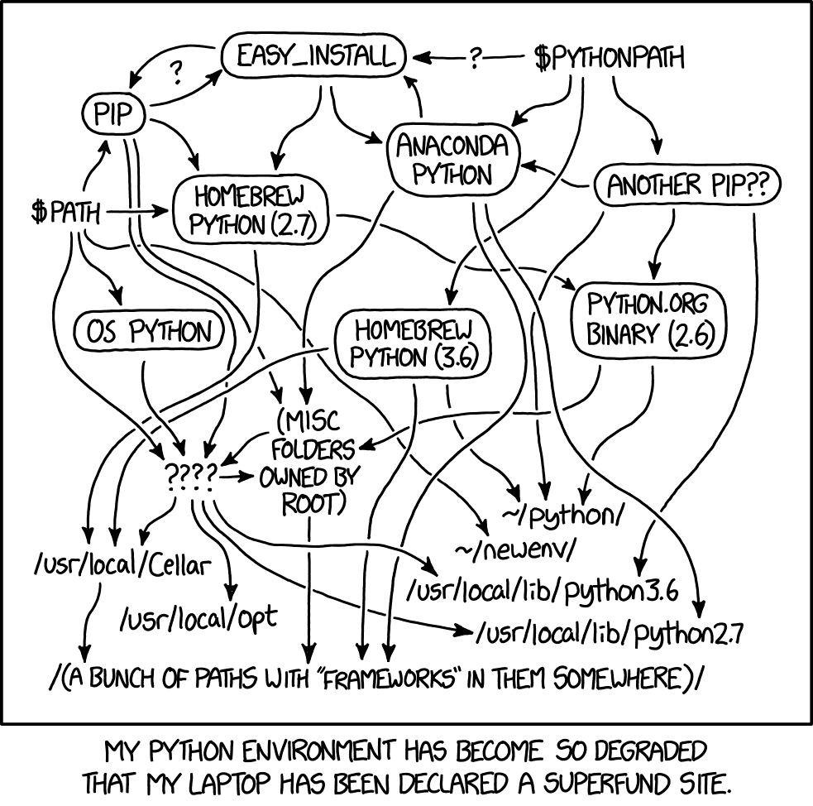
Python distributions
Base Python on Python.org
Anaconda
WinPython
Intel Distribution for Python
Compile from Source
Enthought Python
xkcd.com/1987/

Slide 5

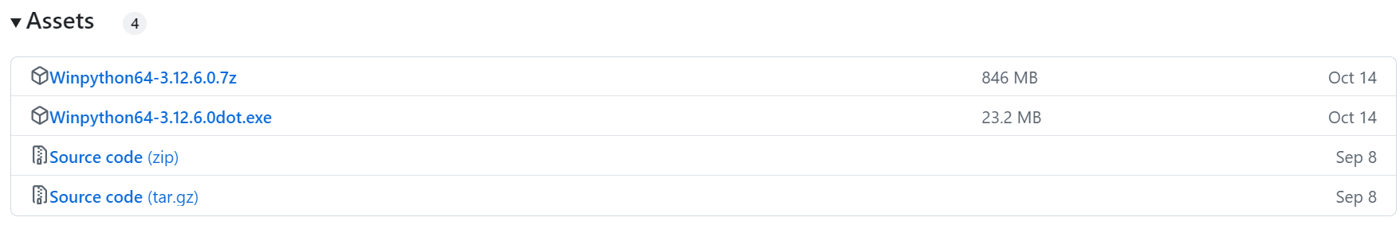
Winpython64-3.12.6.0
WinPython64-3.12.6.0 = Python 3.12.6 64bit with PyQt5 + Spyder : Changelog, Packages
Source: WinPython - Release 2024-04 of September 14th, 2024
Notes:
https://winpython.github.io/
(**) Since WinPython 2019-02, all installers are just 7zip auto-extracts.

Slide 6
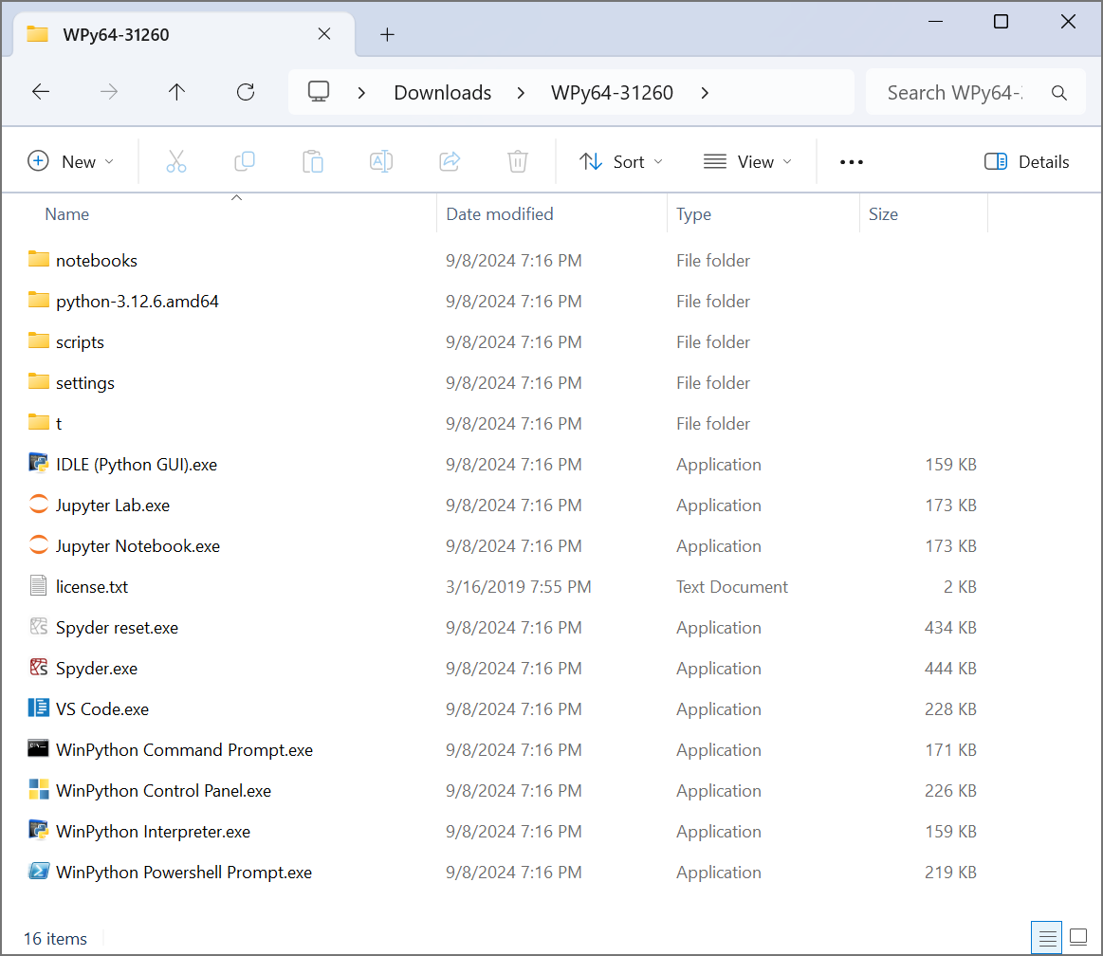
What you get

Slide 7



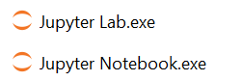
What you get
Command prompt
WinPython Interpreter
VSCode
Jupyter

Slide 8
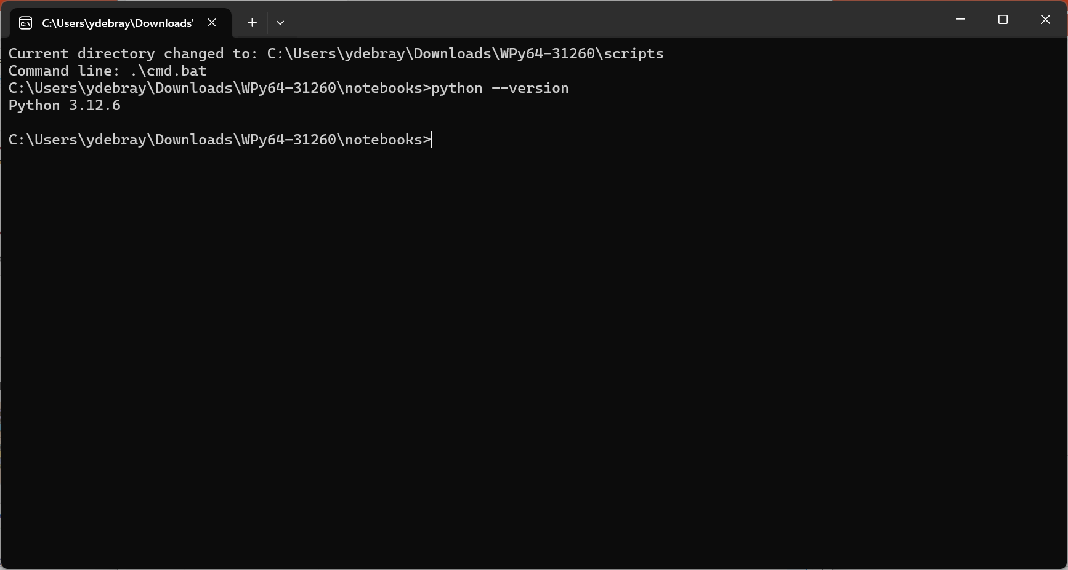
Check install in the COMMAND PROMPT

Slide 9
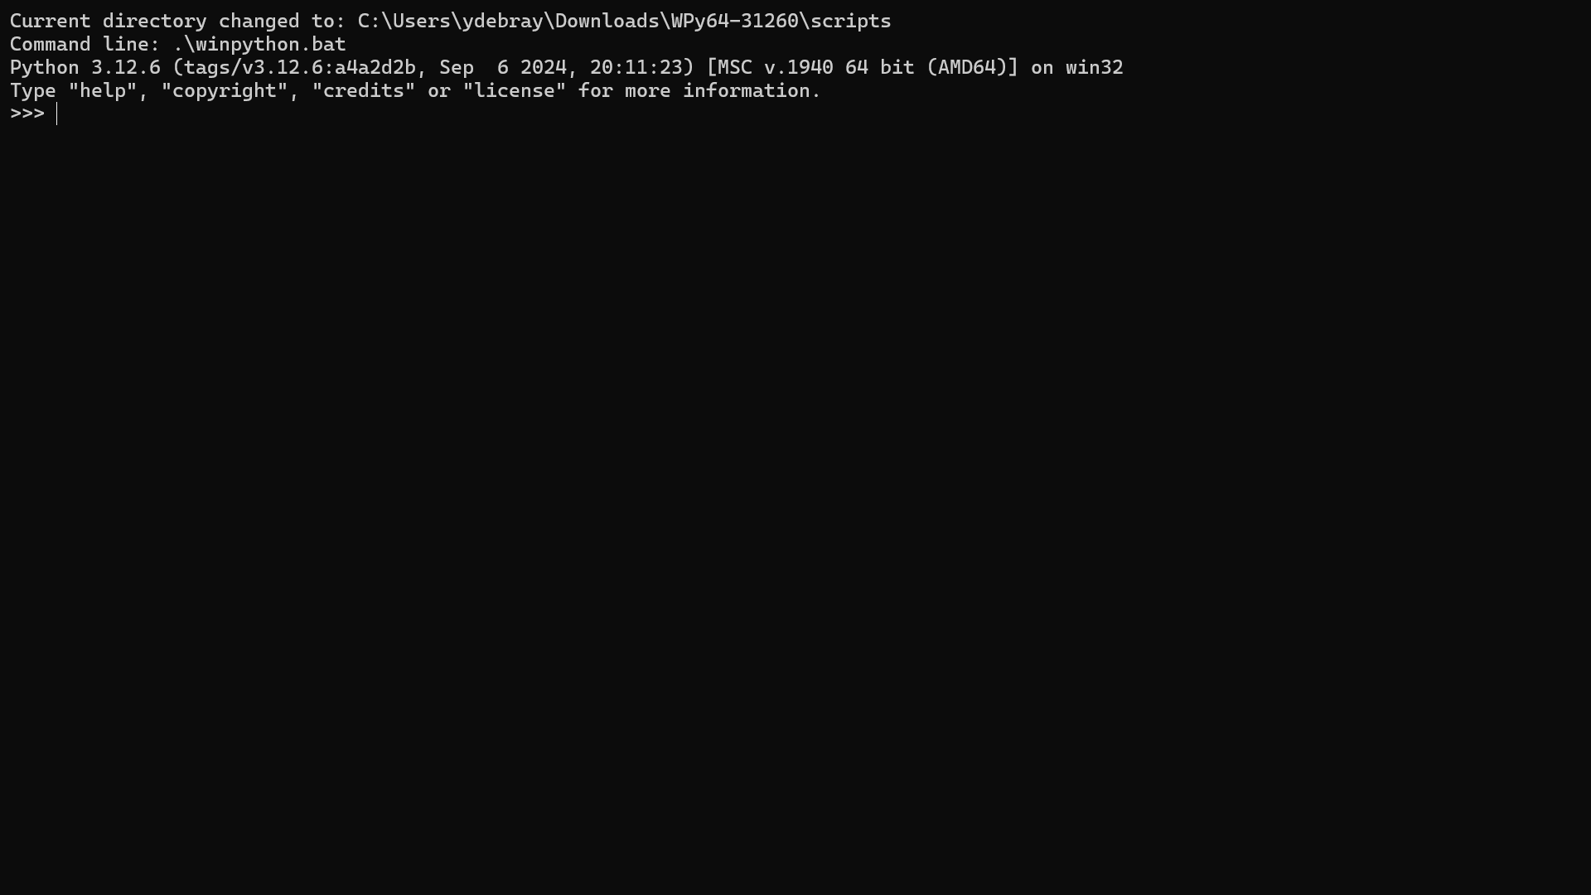
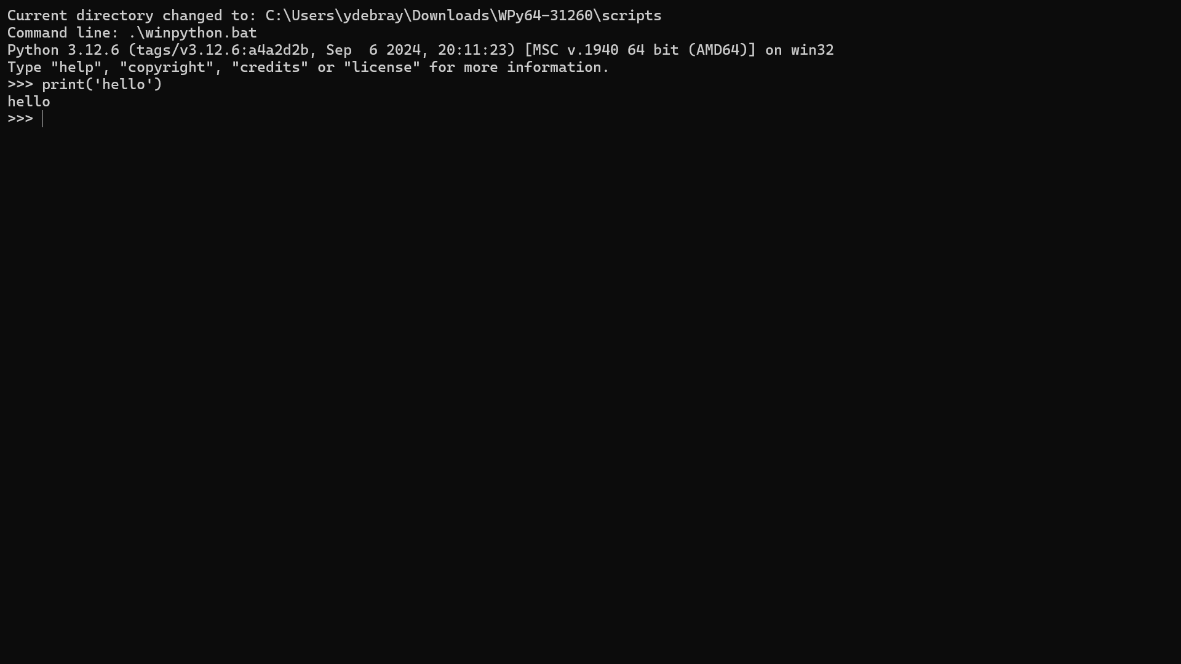
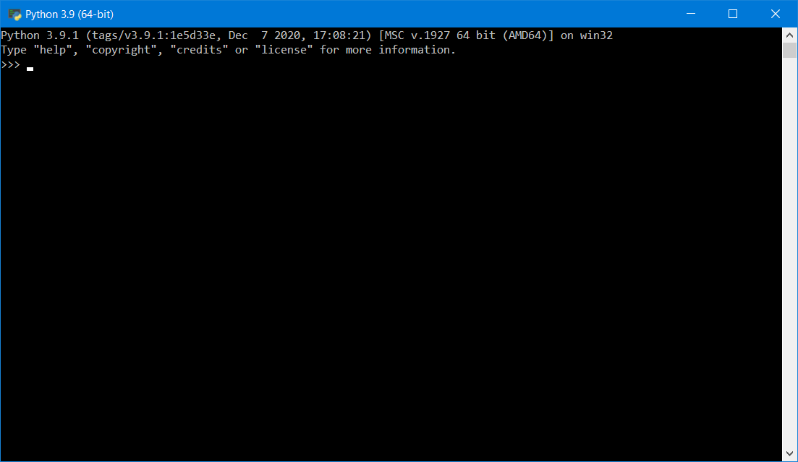
First steps with the Python Interpreter
First steps with the Python Interpreter

Slide 10
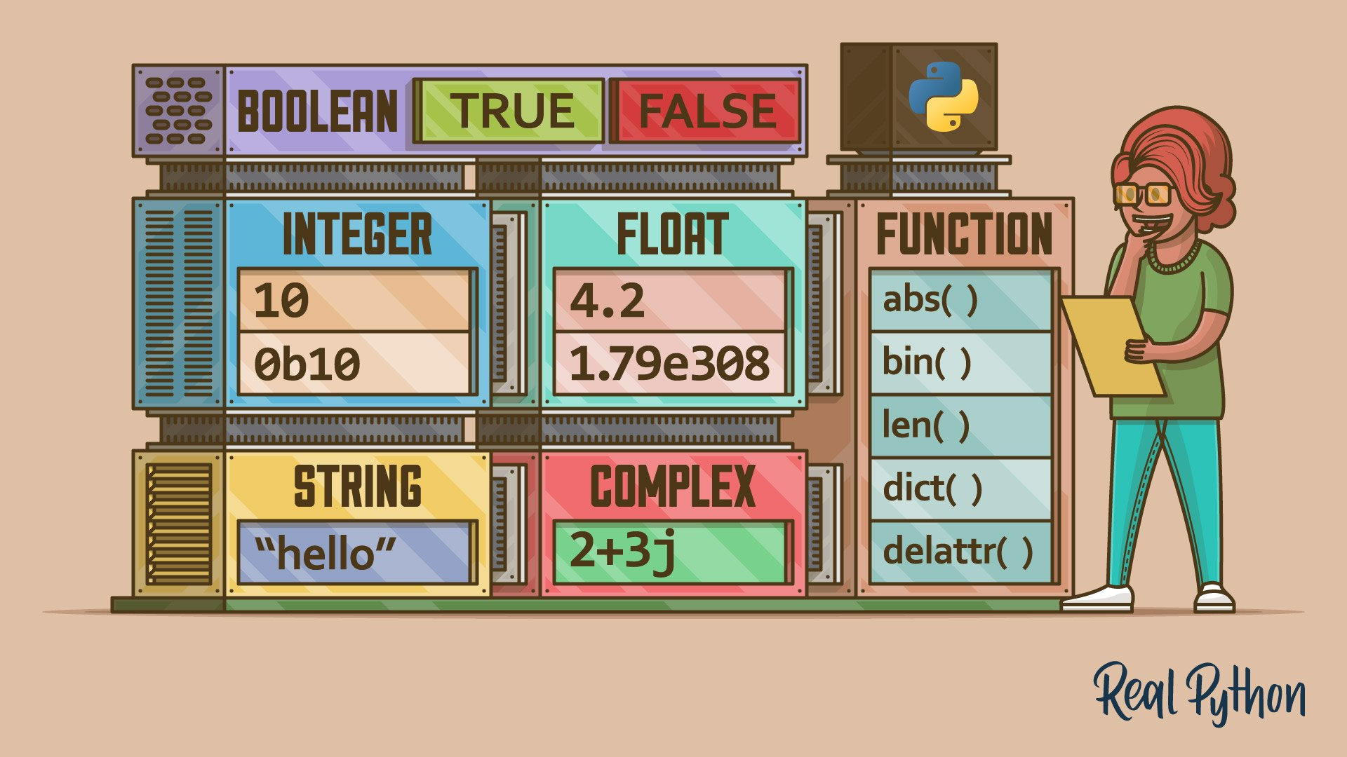
https://realpython.com/python-data-types/
Notes:
https://realpython.com/python-data-types/
https://realpython.com/python-data-structures/

Slide 11
1. Datatypes
Integer
Float
String
List
Dict
More advanced datatypes:
Array
Dataframe
…

Slide 12
Numerics & strings
>>> x = 42 # no semicolon required
>>> type(x)
>>> pi = 3.14
>>> type(pi)
>>> "hello" + x
>>> "hello" + str(x)
Notes:
Python 3: 3/2 = 1.5
Python 2: 3/2 = 1
/!\ Pass by ref (not by value):
>>> a = [1,2]
>>> b = [1,a]
>>> b
[1, [1, 2]]
>>> a[1] = 3
>>> a
[1, 3]
>>> b
[1, [1, 3]]

Slide 13
More on Strings
6.1: A string is a sequence
6.2: Getting the length of a string using len
6.3: Traversal through a string with a loop
6.4: String Slices
6.5: Strings are immutable
6.6: Looping and Counting
6.7: The in operator
6.8: String Comparison
6.9: String Methods
6.E: Strings (Exercises)
6.G: Strings (Glossary)
6.10: Parsing strings
6.11: Format operator
6.12: Debugging
Python for Everybody – Chap 6 Strings
PY4E – HTML

Slide 14

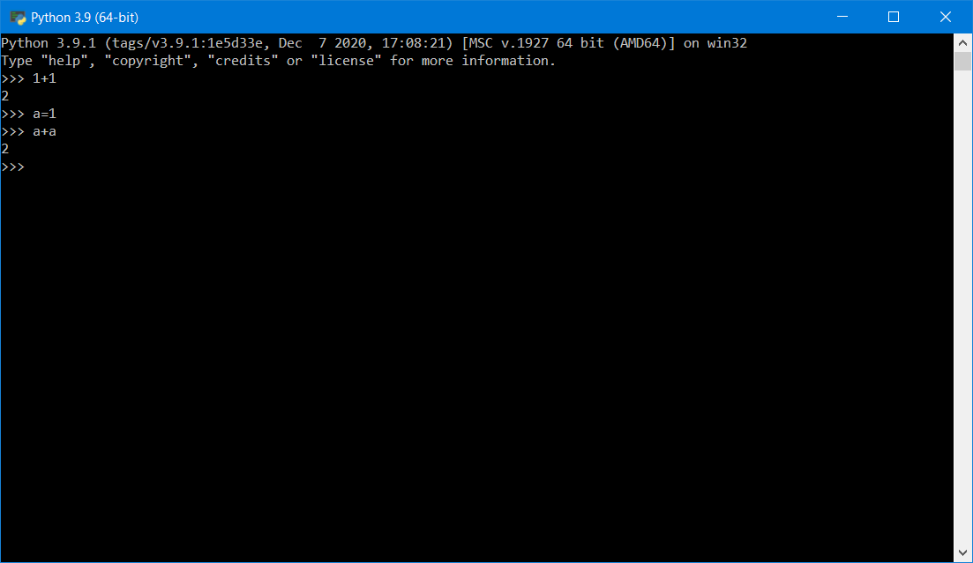
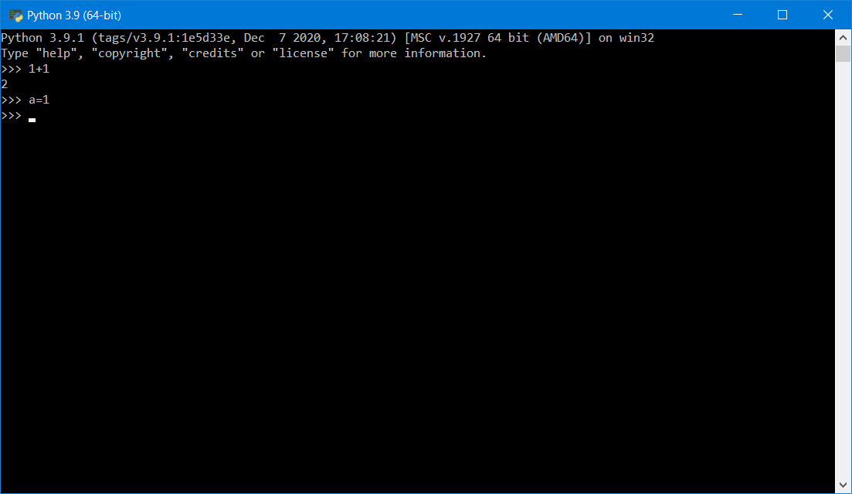
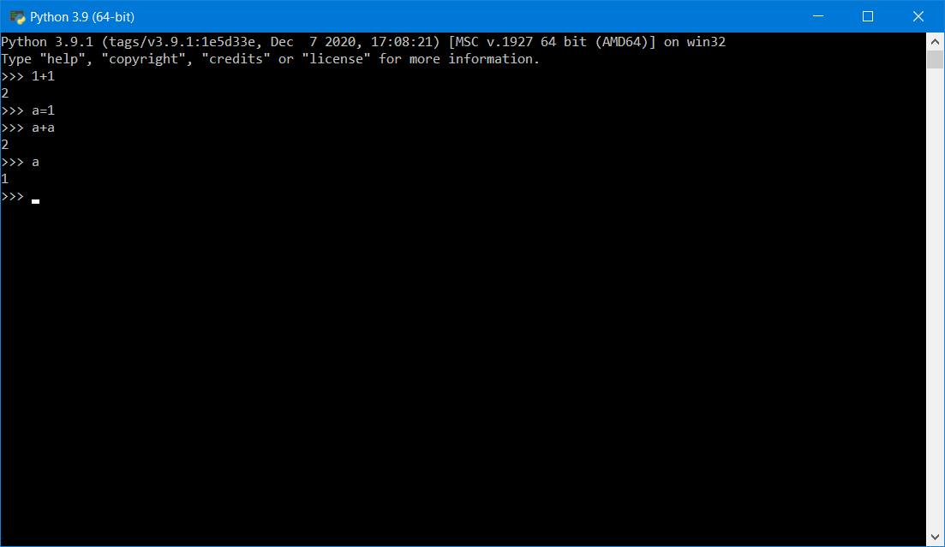
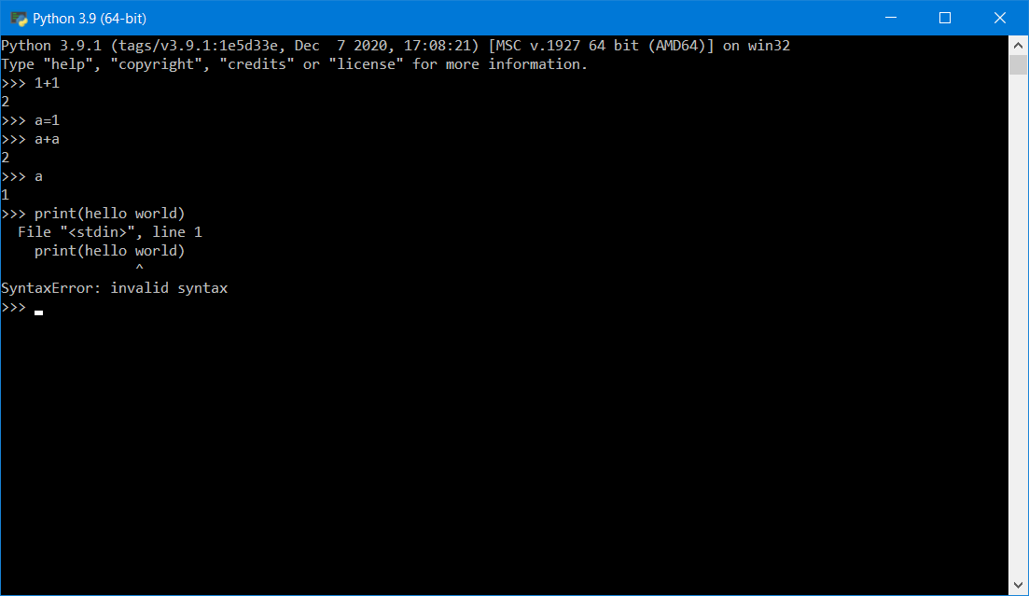
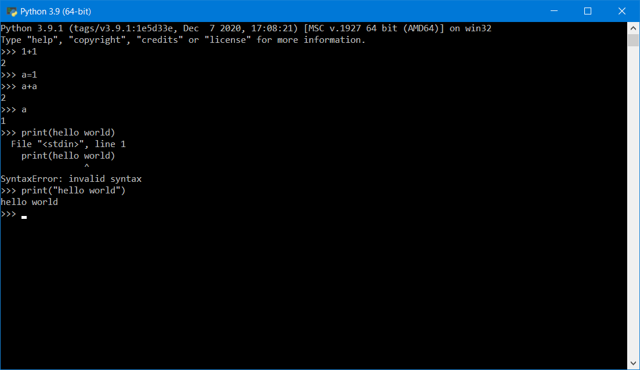
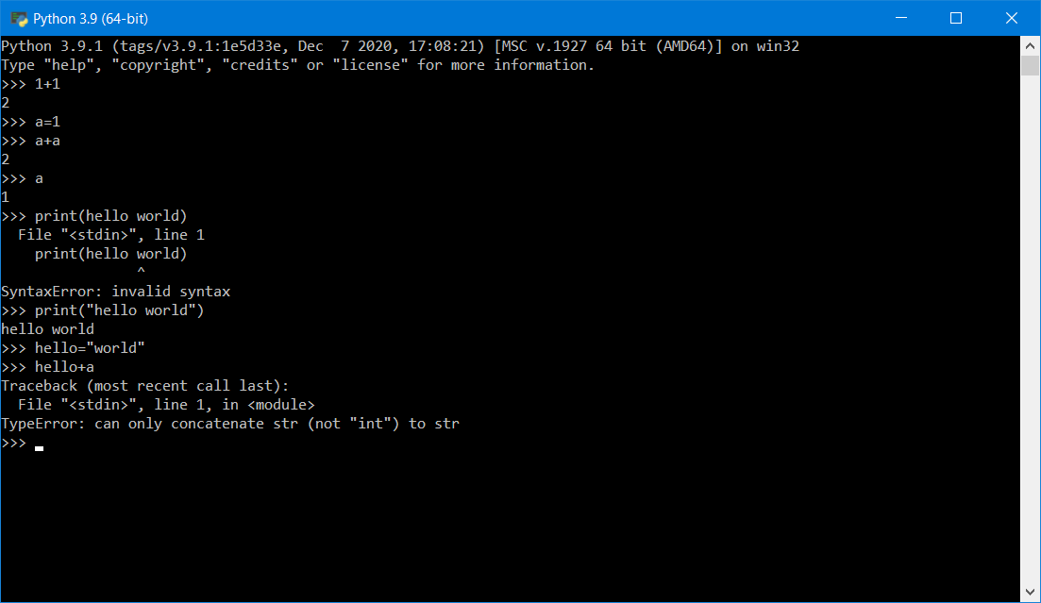
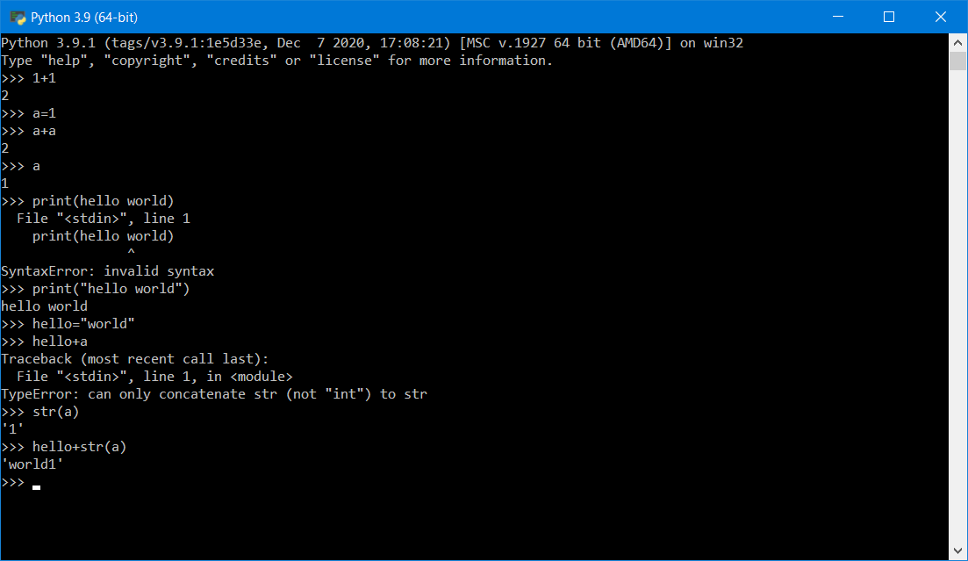

Slide 15
Lists & Dictionaries
>>> t = [1,2,3]
>>> t[1]
>>> t[0]
>>> d = {'temp': 32, 'pressure': 1013}
>>> d[1]
>>> d['temp']
More on lists
More on dictionaries
Notes:
docs.python.org/3/tutorial/datastructures.html#more-on-lists
docs.python.org/3/tutorial/datastructures.html#dictionaries
Dictionaries: so fundamental to the Python ecosystem that they are introduced in the first lesson or two.
MATLAB will be releasing a dictionary type in 2022b

Slide 16
More on Lists
8.1: A list is a sequence
8.2: Lists are mutable
8.3: Traversing a List
8.4: List operations
8.5: List Slices
8.6: List Methods
8.7: Deleting Elements
8.8: Lists and Functions
8.9: Lists and Strings
8.E: Lists (Exercises)
8.G: Lists (Glossary)
8.10: Parsing lines
8.11: Objects and Values
8.12: Aliasing
8.13: List arguments
8.14: Debugging
PY4E - HTML
Python for Everybody - Chap 8 Lists

Slide 17
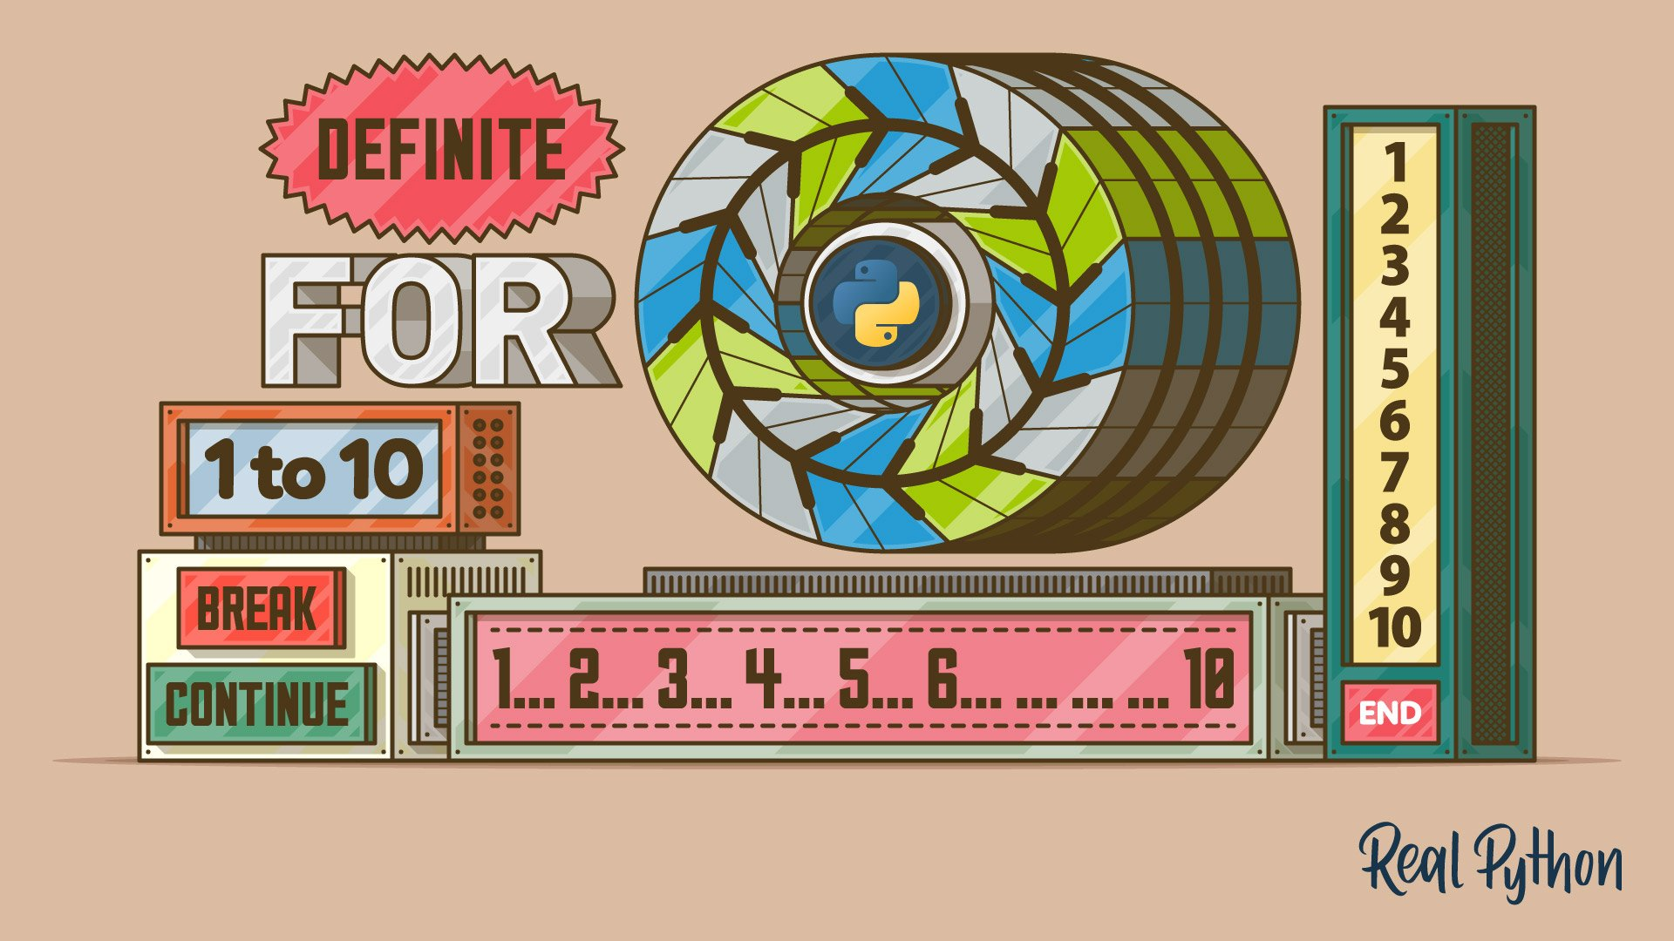

https://realpython.com/python-for-loop/
Notes:
https://realpython.com/python-for-loop/

Slide 18
2. Loops , Conditions, Functions
Loops
Conditions
Functions
Write your first program (in Notepad)

Slide 19
Loops
Code along
>>> for i in t:
... print(i)
>>> words = ['banana', 'oranges', 'apples']
>>> for w in words:
... print(w, len(w))
...
banana 6
oranges 7
apples 6
Notes:
docs.python.org/3/tutorial/controlflow.html#for-statements
docs.python.org/3/tutorial/datastructures.html#list-comprehensions
https://realpython.com/python-for-loop/
https://realpython.com/python-range/
Add list comprehension

Slide 20
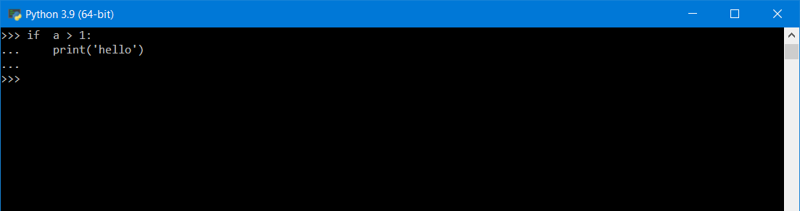
Conditions
>>> if i > 2:
... print(i)
Notes:
docs.python.org/3/tutorial/datastructures.html#more-on-conditions

Slide 21
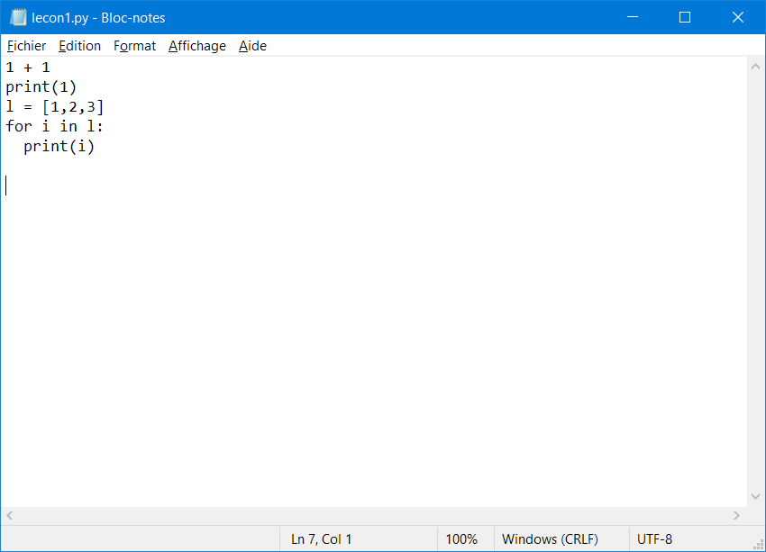

Slide 22
Scripts
test.py
l = [1,2,3]
for i in l:
print(i)
$ python test.py
1
2
3

Slide 23
Functions
test2.py
l = [1,2,3]
def bigger(l):
for i in l:
if i>2:
print(i)
bigger(l)
$ python test2.py
2

Slide 24
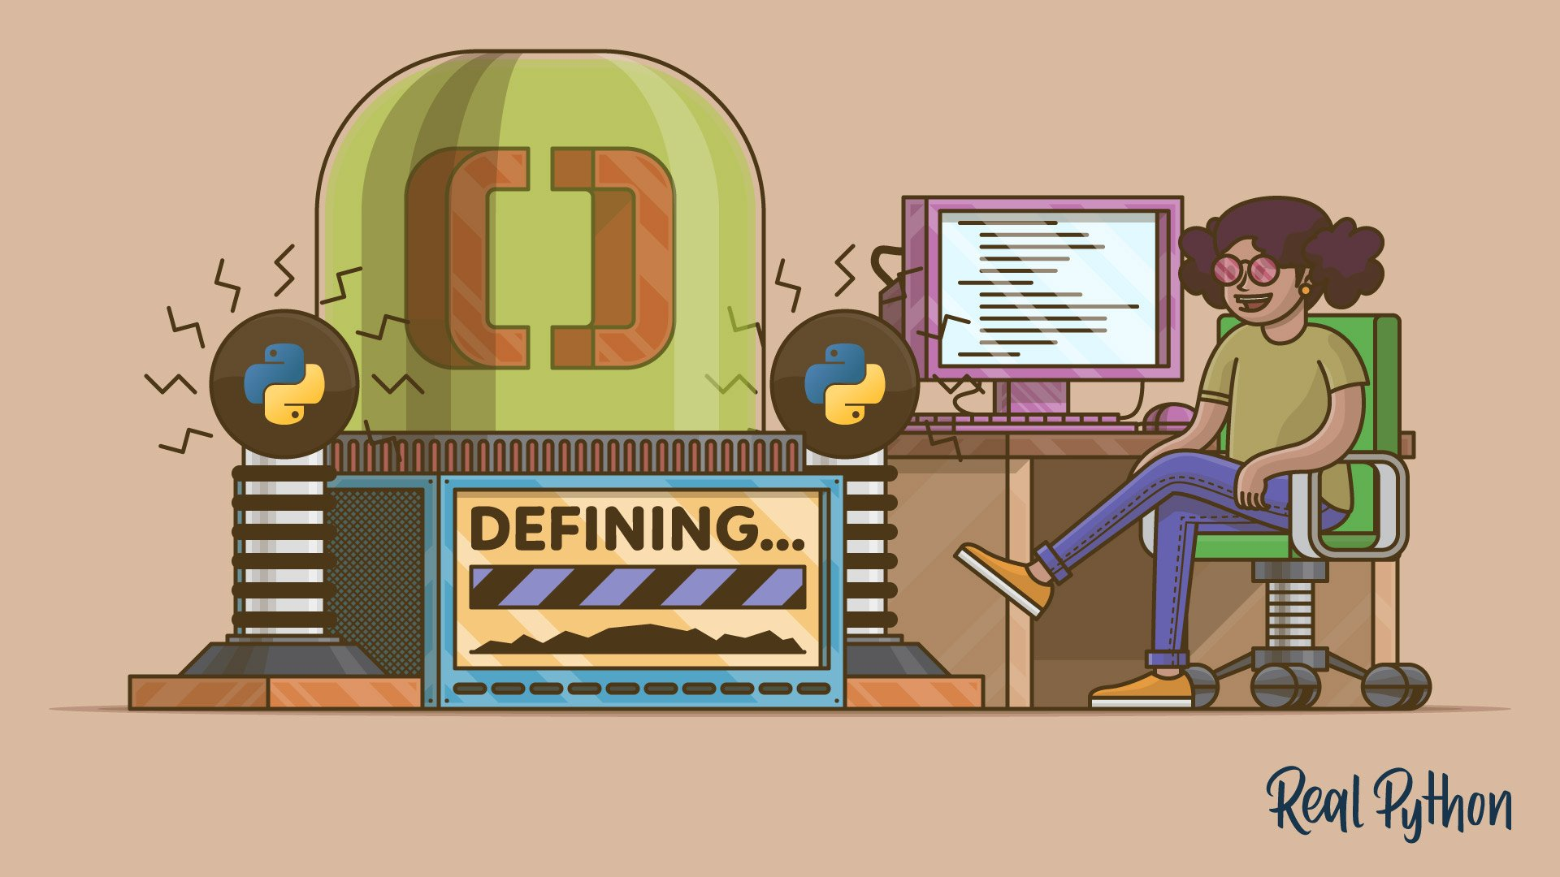
https://realpython.com/defining-your-own-python-function/

Slide 25
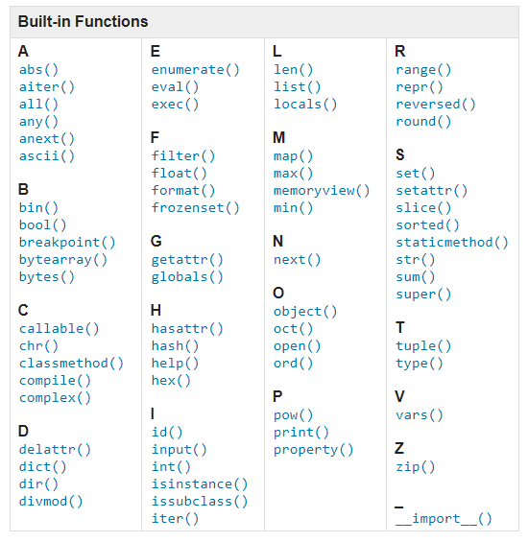
Built-in Functions
Built-in Functions
A abs() aiter() all() any() anext() ascii() B bin() bool() breakpoint() bytearray() bytes() C callable() chr() classmethod() compile() complex() D delattr() dict() dir() divmod() | E enumerate() eval() exec() F filter() float() format() frozenset() G getattr() globals() H hasattr() hash() help() hex() I id() input() int() isinstance() issubclass() iter() | L len() list() locals() M map() max() memoryview() min() N next() O object() oct() open() ord() P pow() print() property() | R range() repr() reversed() round() S set() setattr() slice() sorted() staticmethod() str() sum() super() T tuple() type() V vars() Z zip() _ __import__()
Built-in Functions — Python documentation

Slide 26

https://realpython.com/python-modules-packages/

Slide 27

Standard Modules
>>> import this
>>> import math
>>> math.sqrt(4)
2
>>> from math import sqrt
>>> sqrt(4)
2
Walking Randomly » Python rant: ‘ from foo import * ‘ is bad
Notes:
docs.python.org/3/reference/import.html
docs.python.org/3/tutorial/modules.html
docs.python.org/3/library/math.html
/!\ `from math import *` is very bad and should be punished by death
https://walkingrandomly.com/?p=6209
Python doesn’t just have one version of a function….there are many. E.g. look at all the different behaviours of sqrt!
Good: Namespaces are good. MATLAB doesn’t have them. This is bad
Bad: You are a user and you want to do foo. Which foo do you use? Even the official toolchain has many variants. Fun times!

Slide 28
Standard Modules (2) Exercise
Import the urlopen function from the urllib.request submodule
>>> import urllib.request
>>> url = "https://samples.openweathermap.org/"
>>> res = urllib.request.urlopen(url)
>>> res.read()
Notes:
docs.python.org/3/tutorial/modules.html
docs.python.org/3/library/math.html
docs.python.org/3/library/urllib.request.html
docs.python.org/3/library/urllib.request.html#urllib.request.urlopen
Proceed further with:
https://samples.openweathermap.org/data/2.5/weather?q=London&appid=b6907d289e10d714a6e88b30761fae22

Slide 29
User-defined Modules
my_mod.py
def my_fun(l):
for i in l:
if i%2 == 0:
print(i)
>>> import my_mod
>>> l = [1,2,3]
>>> my_mod.my_fun(l)
>>> from my_mod import my_fun
>>> l = [1,2,3]
>>> my_fun(l)
Notes:
Interaction/Question to the audience: How would you do that in MATLAB? By default in MATLAB one function per file
AND
Equivalent of +my_mod in MATLAB

Slide 30
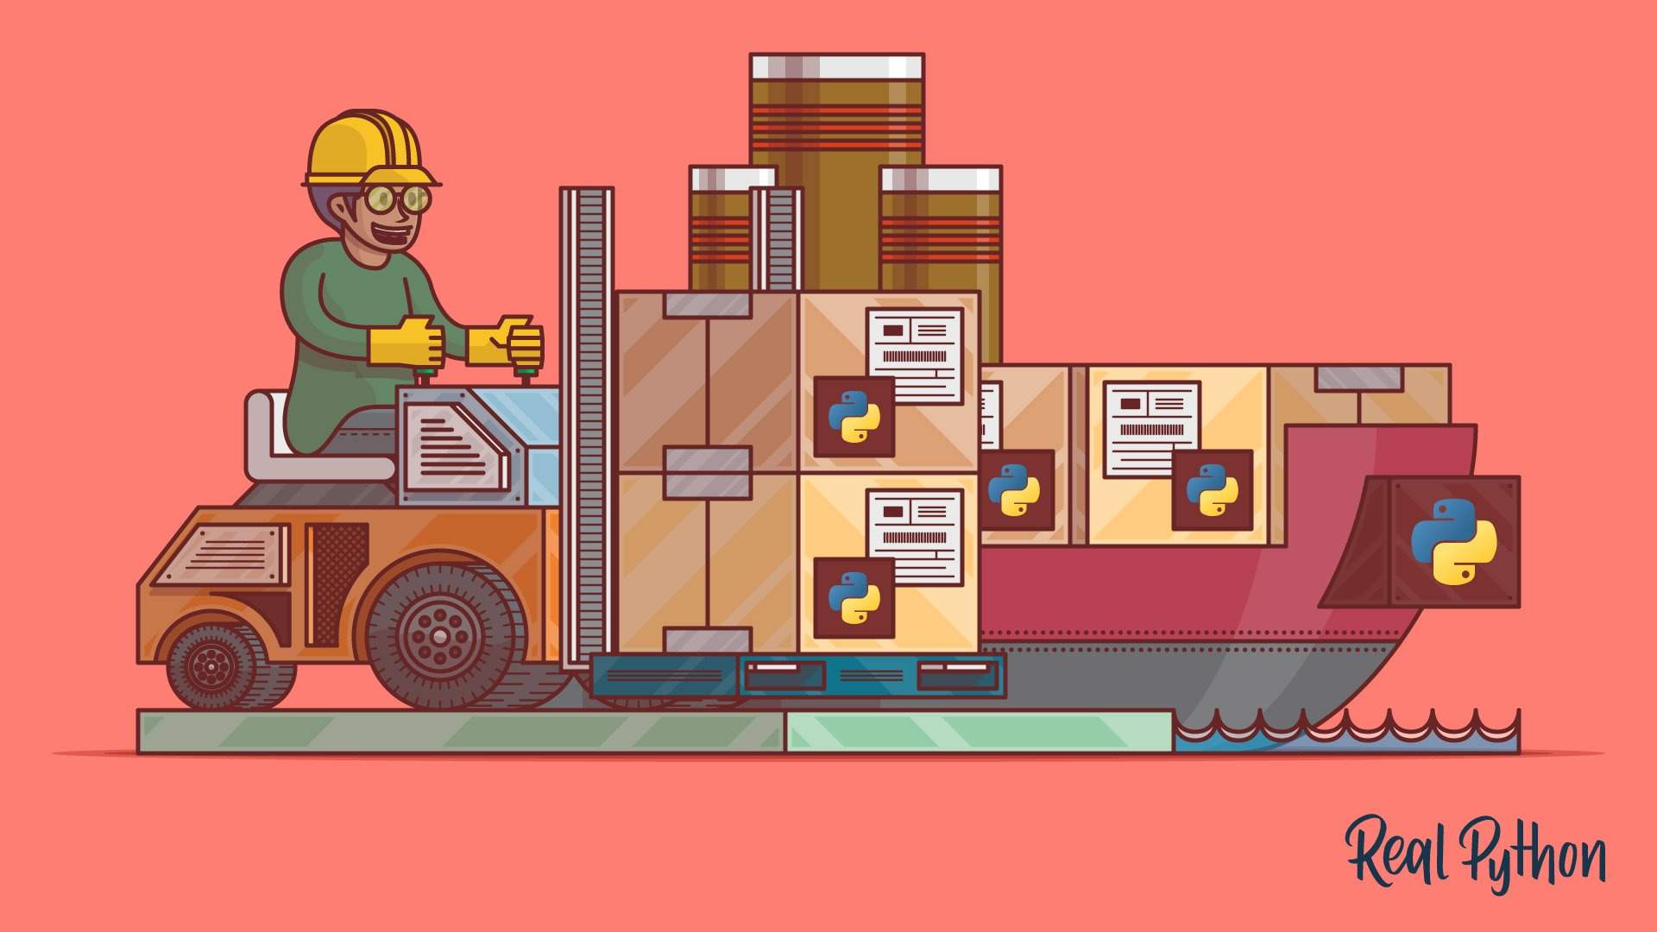

More on import and namespaces
https://realpython.com/python-import/
https://realpython.com/python-namespaces-scope/

Slide 31
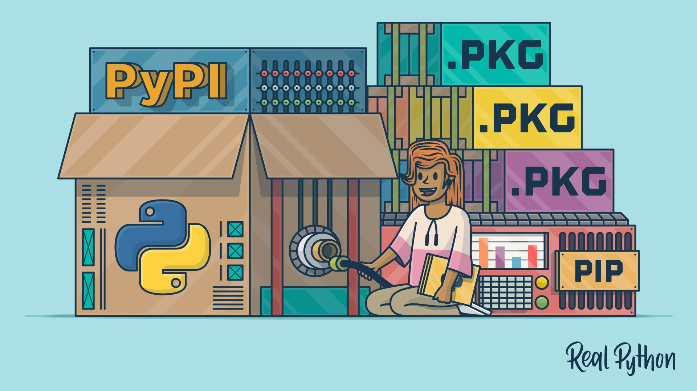
https://realpython.com/what-is-pip/

Slide 32


Development environments

Slide 33

https://realpython.com/jupyter-notebook-introduction/
Notes:
Critical element that made Python

Slide 34



Jupyter
Notebook Format
Interactive Computing Protocol
Kernel
Notes:
Jupyter Notebooks have become over the years, one of the most used and appreciated data science tools. They combine text (as Markdown), code, and output (numerical and graphical). Notebooks help data scientist to communicate goals, methods and results. It can be seen as an executable form of textbook or scientific paper.
Jupyter stands for Julia, Python and R, but it is also an homage to Galileo’s notebooks recording the discovery of the moons of Jupiter.
Jupyter is a project that spun off in 2014 from IPython. IPython stands for Interactive Python and was created in 2001 by Fernando Perez. He drew his inspiration from Maple and Mathematica that both had notebook environments. He really liked the Python language, but he felt limited by the interactive prompt to do scientific computing. So he wrote a python startup file to provide the ability to hold state and capture previous results for reuse, and adding some nice features like loading the Numeric library and Gnuplot. 'ipython-0.0.1' was born, a mere 259 lines to be loaded as $PYTHONSTARTUP.
Around 2006, the IPython project took some inspiration from another open-source project called Sage. The Sage Notebook was taking the route of using the filesystem for notebook operations. You couldn’t meaningfully list files with ls or move around the filesystem by changing directory with cd. Sage would execute your code in hidden directories with each cell actually being a separate subdirectory.
In 2010, the architecture of IPython evolved by separating the notebook front-end from the kernel executing Python code, and communicating between the two with the ZeroMQ protocol. This design enabled the development of a Qt client, a Visual Studio extension, and finally a web frontend.

Slide 35
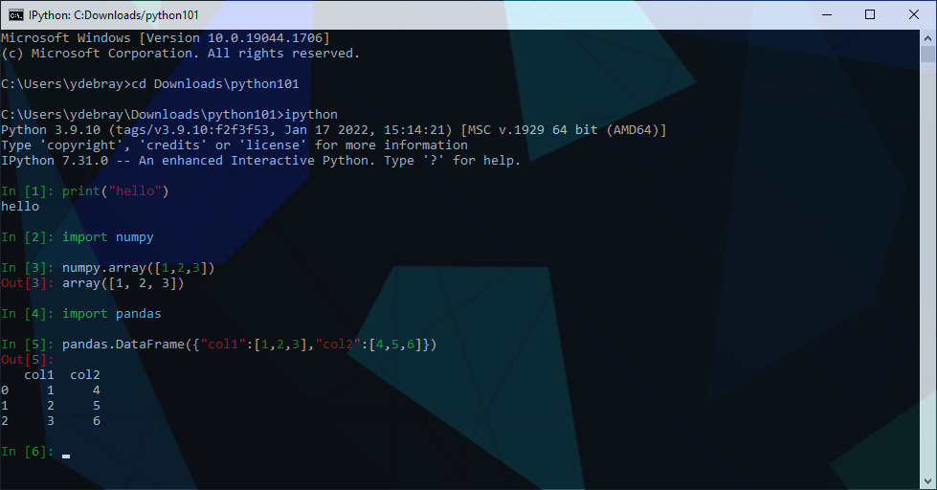
Before Jupyter IPython

Slide 36
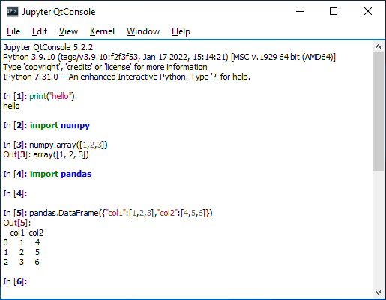
Before Jupyter Ipython Qt Console

Slide 37
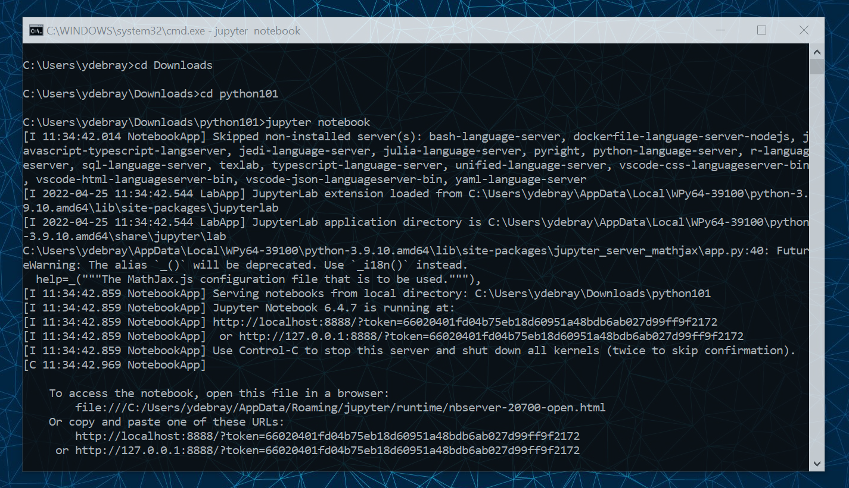

Slide 38
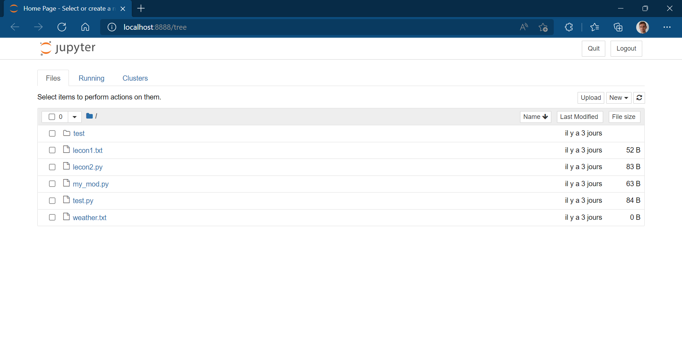

Slide 39
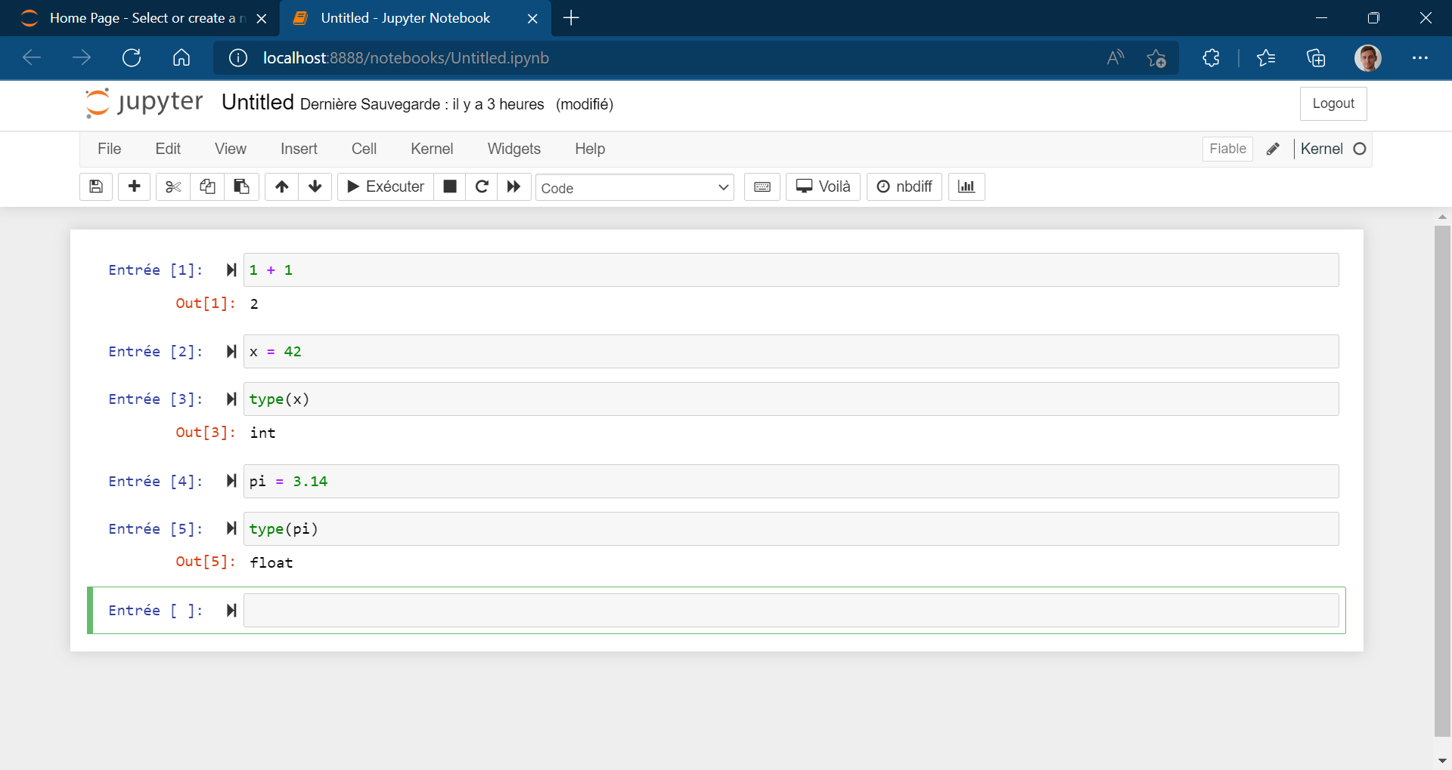
Notes:
How notebooks are shared >> teaching, github

Slide 40
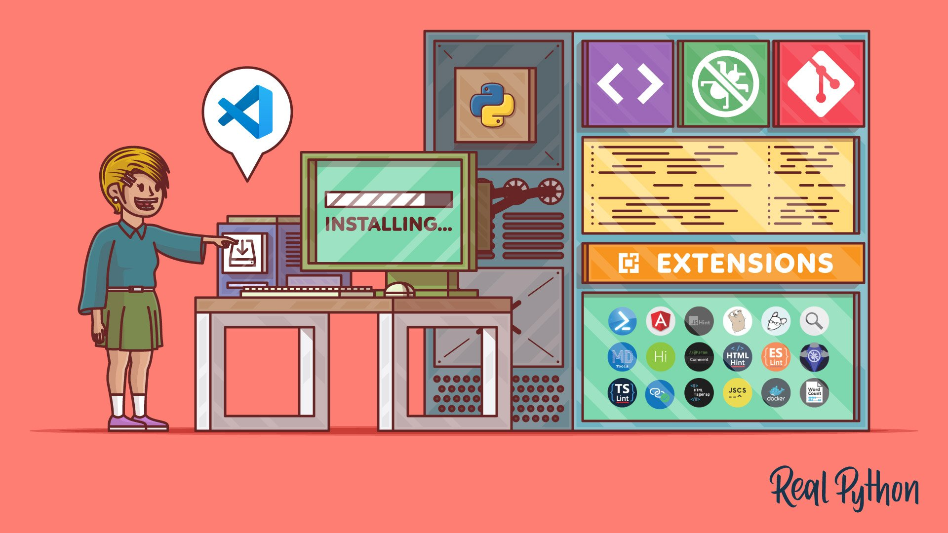
https://realpython.com/python-development-visual-studio-code/

Slide 41
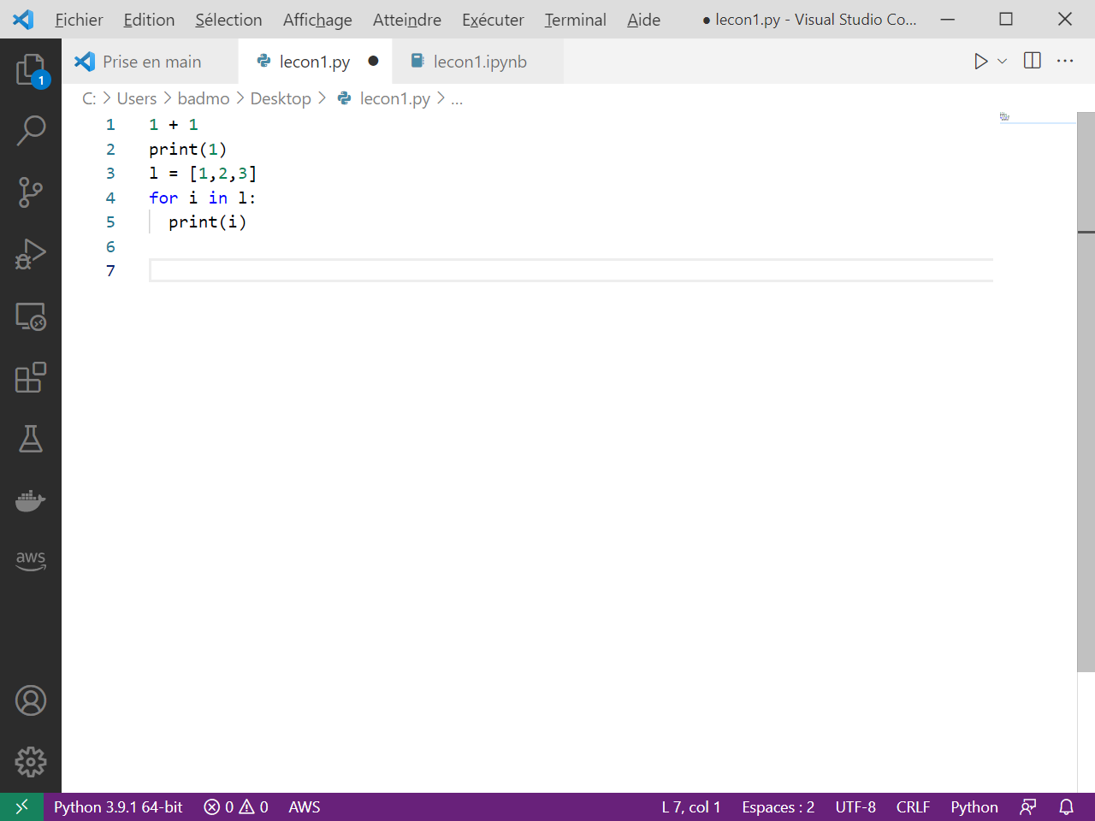
Visual Studio Code Recommended editor for Python
https://code.visualstudio.com/

Slide 42
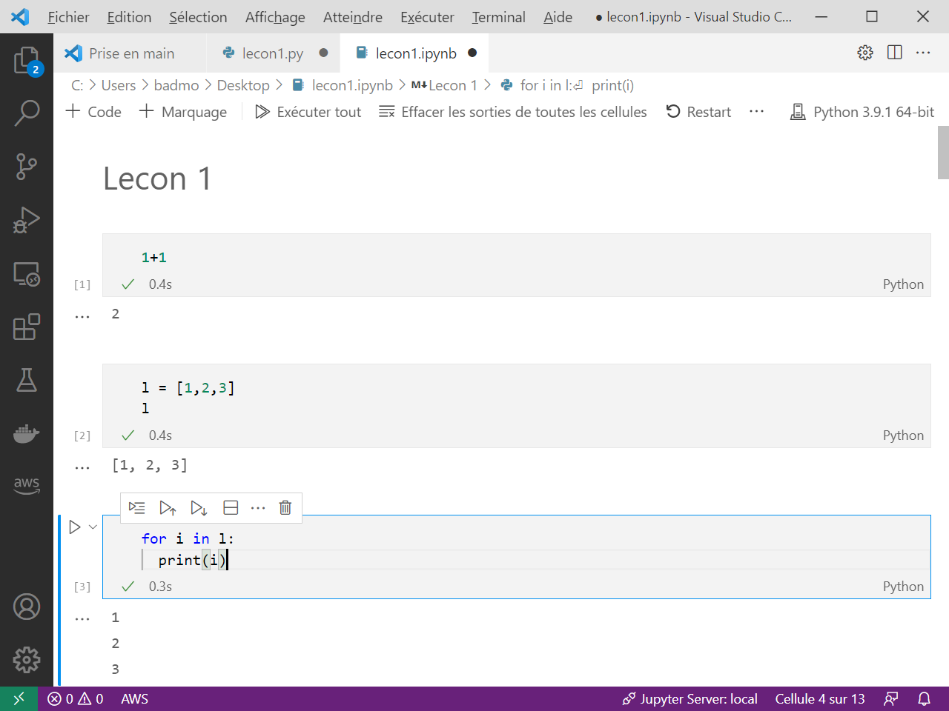
Notebook format for interactivity

Slide 43
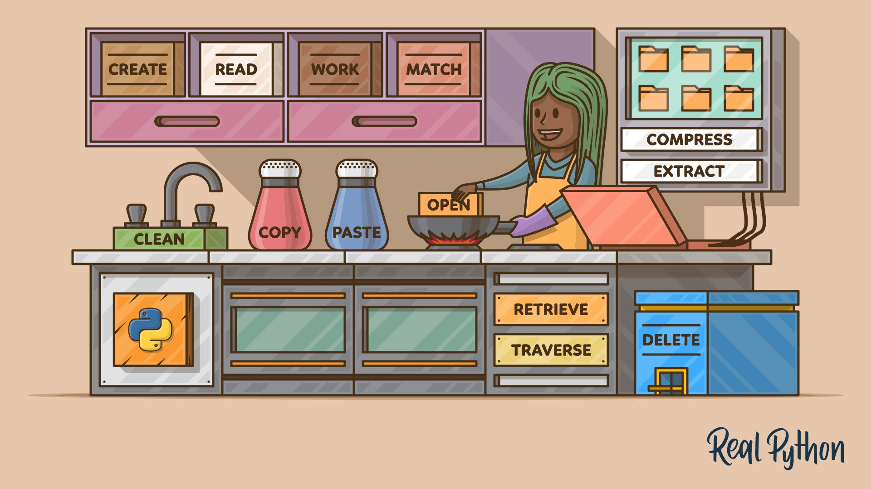
https://realpython.com/working-with-files-in-python/
Notes:
https://realpython.com/working-with-files-in-python/
https://realpython.com/read-write-files-python/

Slide 44
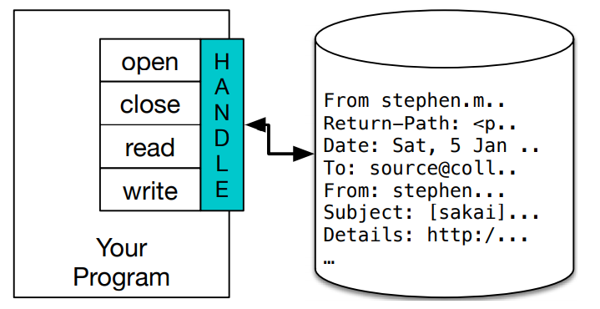
3. Import/export data from files
>>> fhand = open('mbox.txt’)
>>> print(fhand)
<_io.TextIOWrapper name='mbox.txt' mode='r' encoding='cp1252'>
Python for Everybody – Chap 7 Files

Slide 45
Reading files
fhand = open('mbox-short.txt’)
count = 0
for line in fhand:
count = count + 1
print('Line Count:', count)
https://www.py4e.com/code3/mbox.txt

Slide 46
Writing files
>>> fout = open('output.txt', 'w’)
>>> line1 = "This here's the wattle,\n“
>>> fout.write(line1)
>>> line2 = 'the emblem of our land.\n’
>>> fout.write(line2)
>>> fout.close()

Slide 47
More on Files
7.1: Persistence
7.2: Opening Files
7.3: Text files and Lines
7.4: Reading Files
7.5: Searching through a File
7.6: Letting the user choose the file name
7.7: Using try, except, and open
7.8: Writing Files
7.9: Debugging
7.E: Files (Exercises)
7.G: Files (Glossary)
Python for Everybody – Chap 7 Files

Slide 48

https://realpython.com/python-virtual-environments-a-primer/
Notes:
https://realpython.com/python-virtual-environments-a-primer/

Slide 49
Virtual Environments venv
$ python -m venv env
$ .\env\Scripts\activate
$ (env) pip install –r requirements.txt
Notes:
If you have different projects leveraging different versions of the same
package, or if you want a way to replicate your production environment
in a clean space, use [Python virtual environment](https://docs.python.org/3/tutorial/venv.html).
It’s a type of virtualization at the language level (like Virtual Machine at the
Machine level, or Docker container at the Operating System level). This
is the default way (shipped with base Python) to create a virtual
environment called `env`

Slide 50
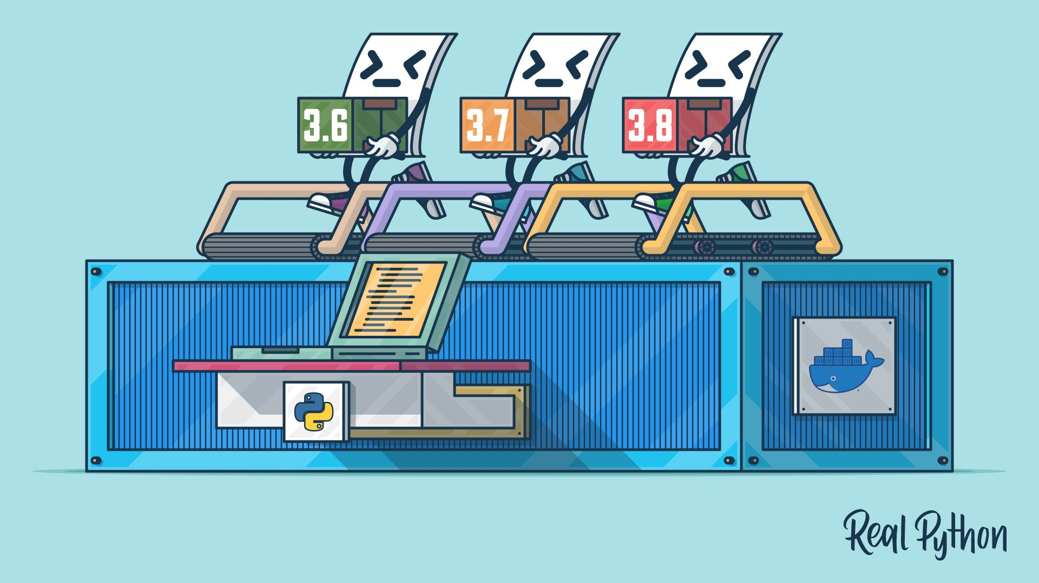
https://realpython.com/python-versions-docker/
Notes:
https://realpython.com/offline-python-deployments-with-docker/

Slide 51
Docker
Dockerfile
FROM python:3.7.5-slim
WORKDIR /usr/src/app
RUN python -m pip install \
numpy \
pandas
COPY test.py .
CMD ["python", "test.py"]
$ docker build –t test .
[+] Building 71.3s (9/9) FINISHED
$ docker run --rm test
1
2
3

Slide 52

https://realpython.com/python-testing/

Slide 53
Unit testing
test_sum.py
def test_sum():
assert sum([1, 2, 3]) == 6, "Should be 6"
if __name__ == "__main__":
test_sum()
print("Everything passed")
$ python test_sum.py
Everything passed

Slide 54


More on Object-Oriented Programming
https://realpython.com/python3-object-oriented-programming/
https://realpython.com/python-super/

Slide 55
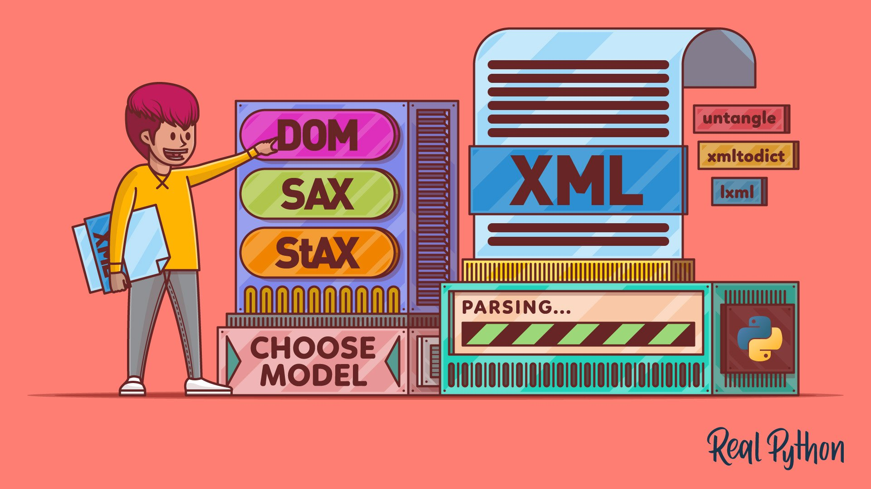
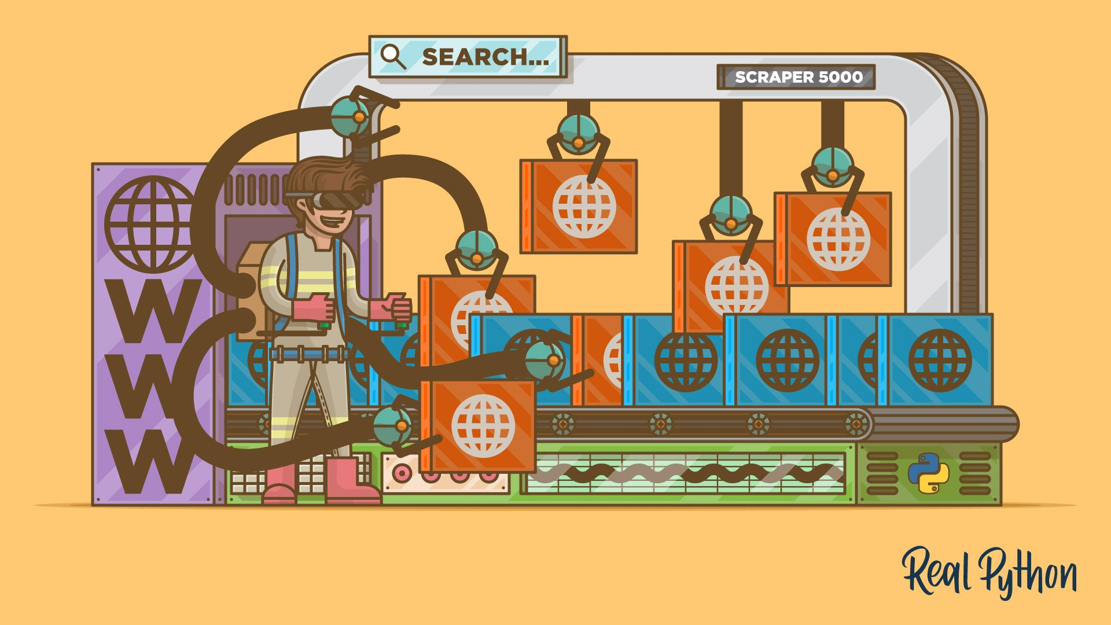
More on text processing
https://realpython.com/python-xml-parser/
https://realpython.com/beautiful-soup-web-scraper-python/
Notes:
https://realpython.com/python-web-scraping-practical-introduction/

Slide 56
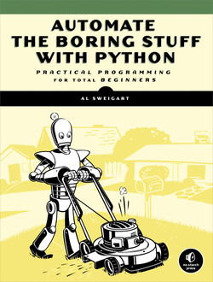
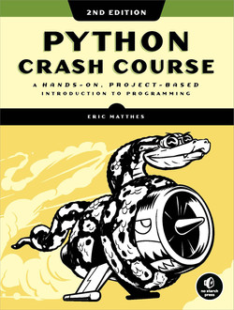
More resources Books
https://automatetheboringstuff.com/
Notes:
https://github.com/realpython/materials

Slide 57
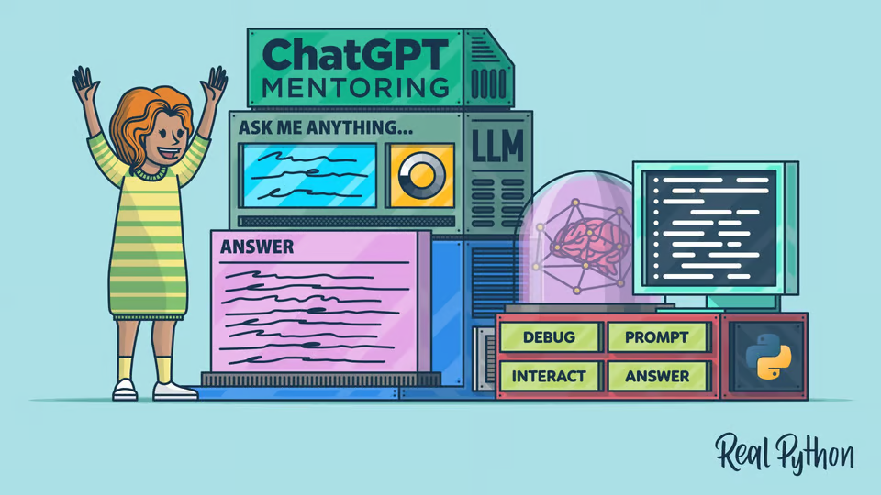
Notes:
https://realpython.com/chatgpt-coding-mentor-python/

Slide 58
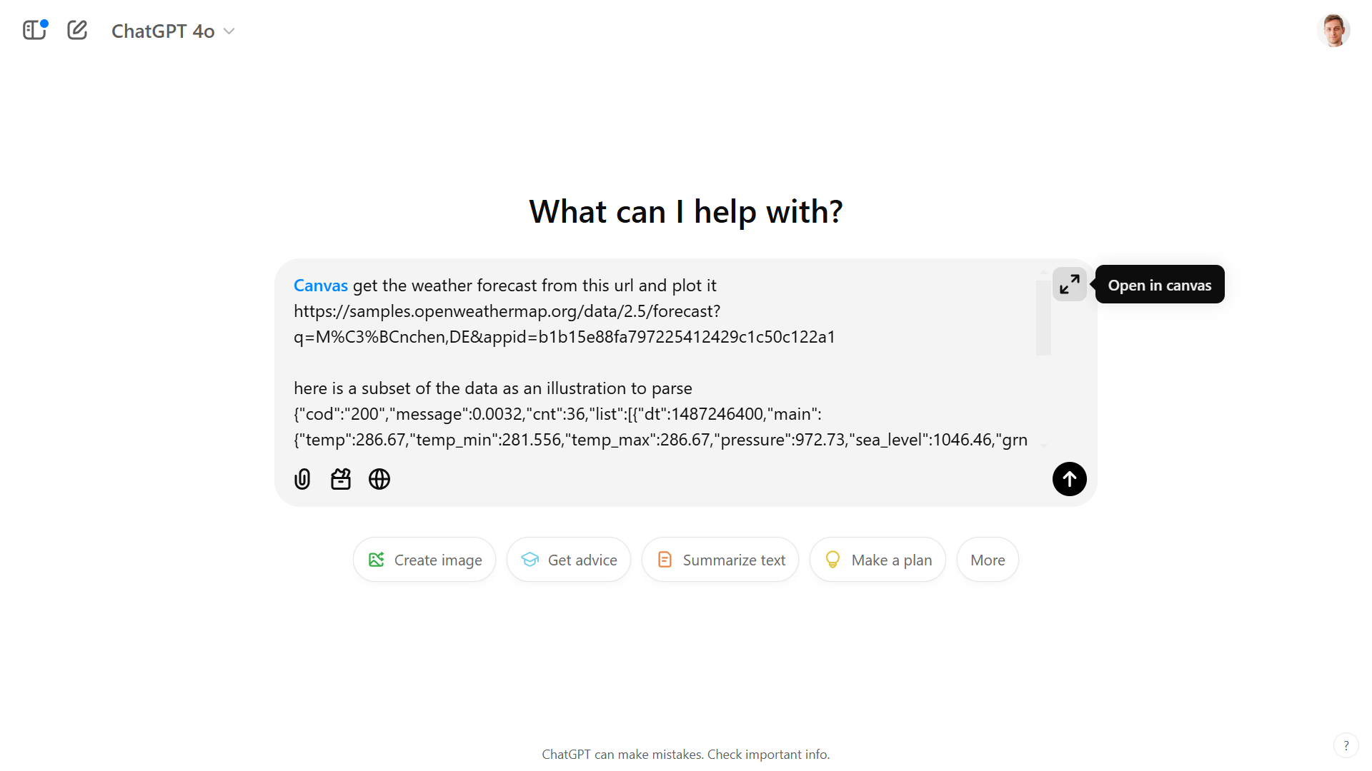
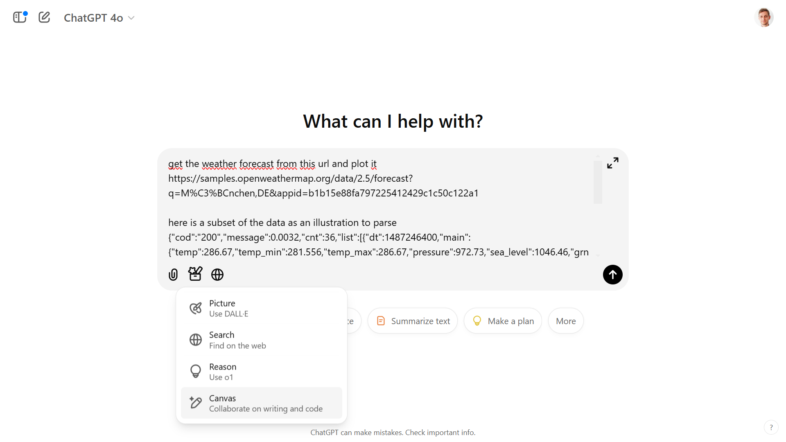
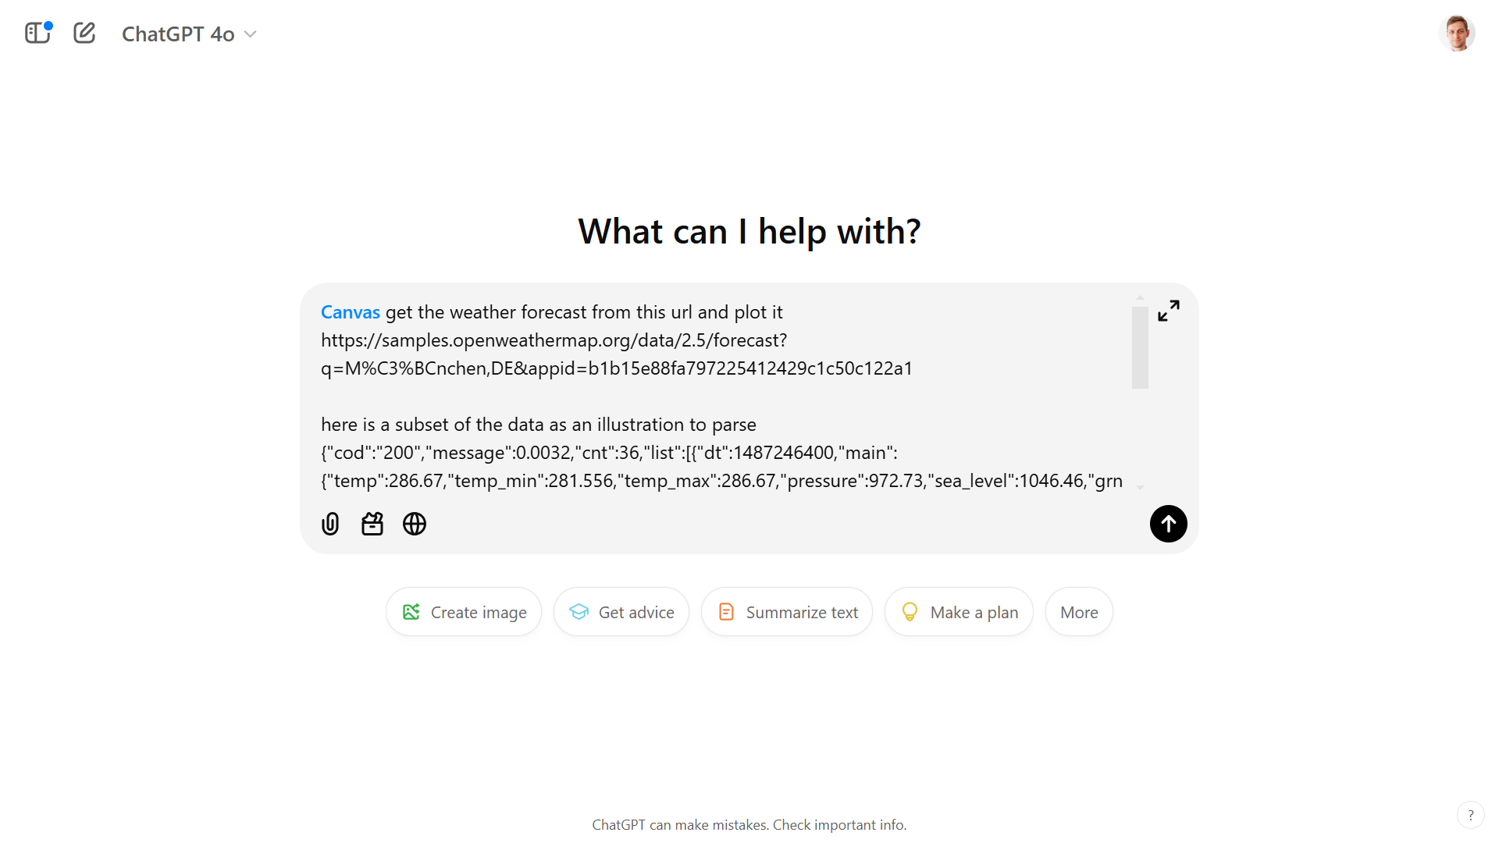

Slide 59
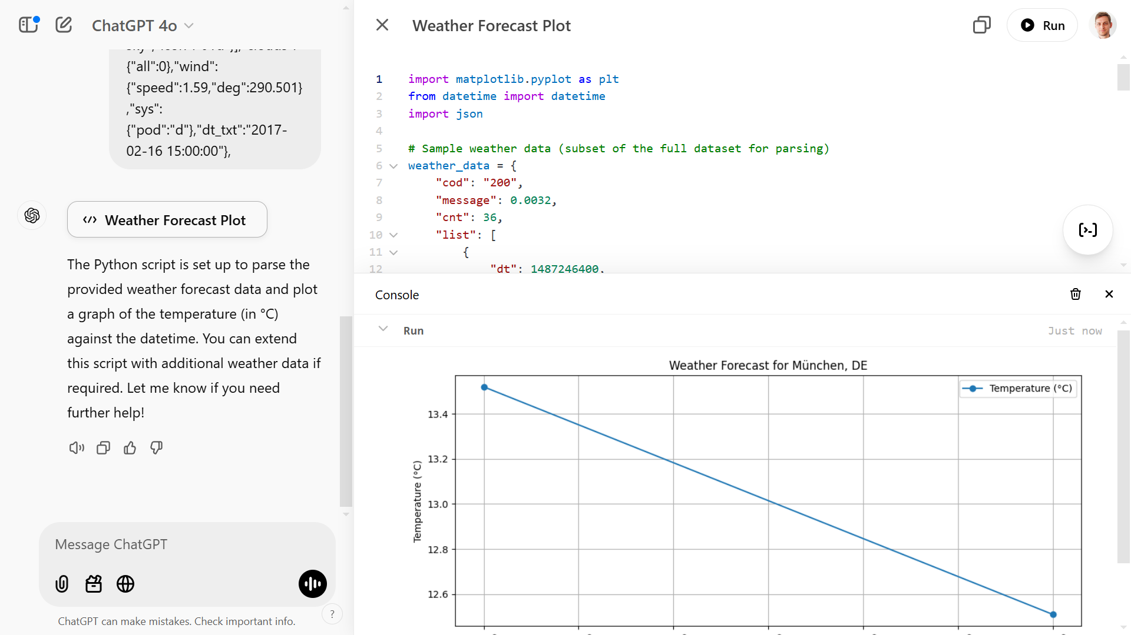

Slide 60
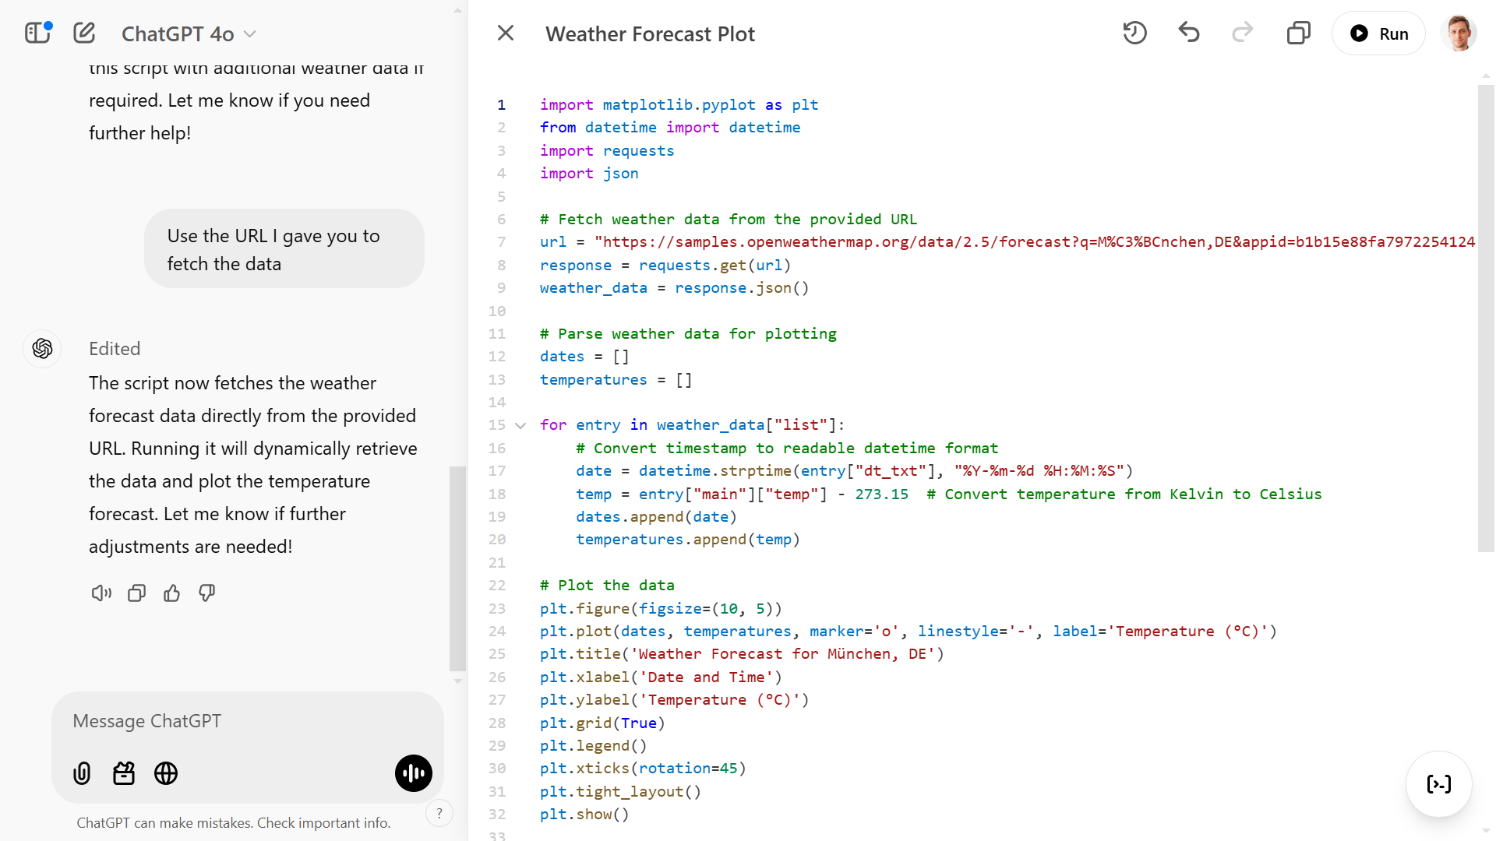

Slide 61
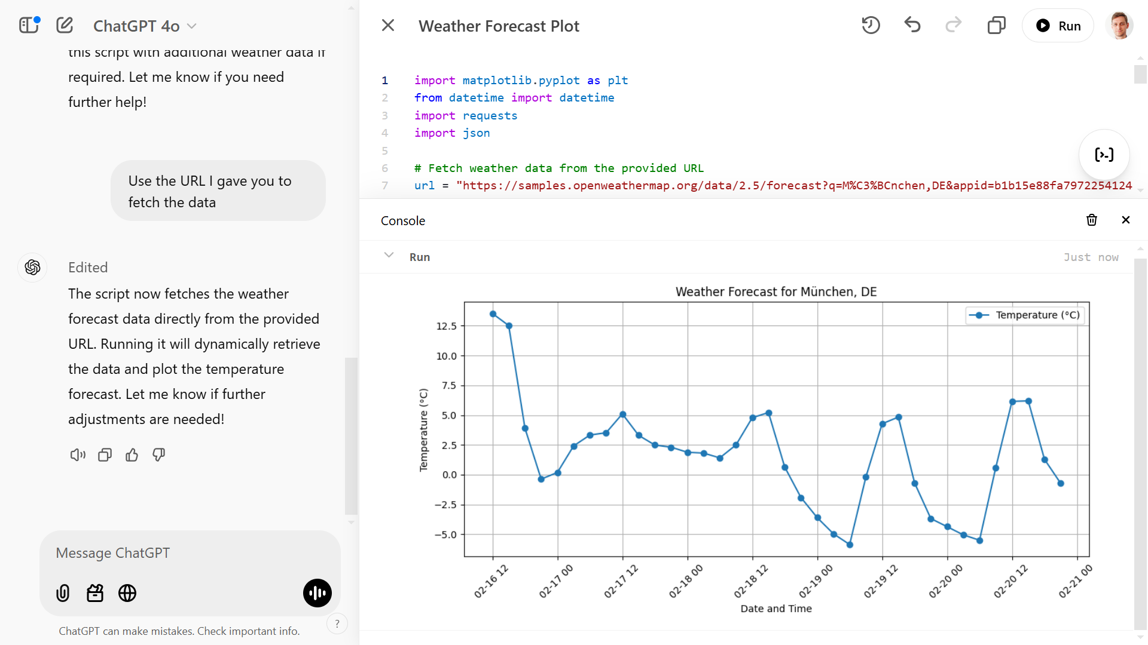

Slide 62
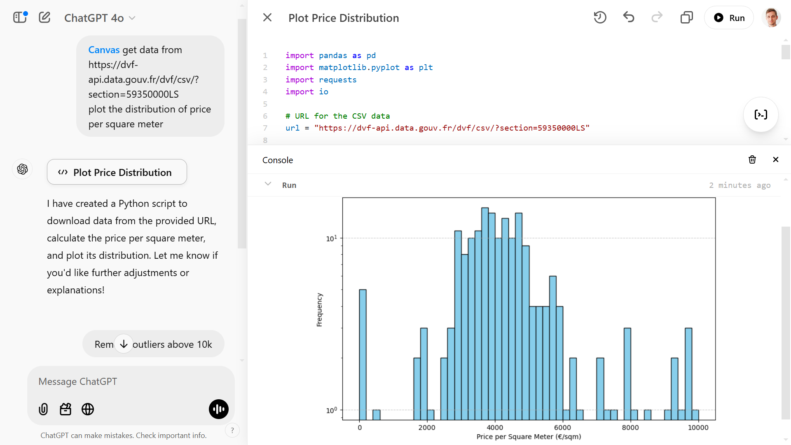

Slide 63
Exercises

Slide 64
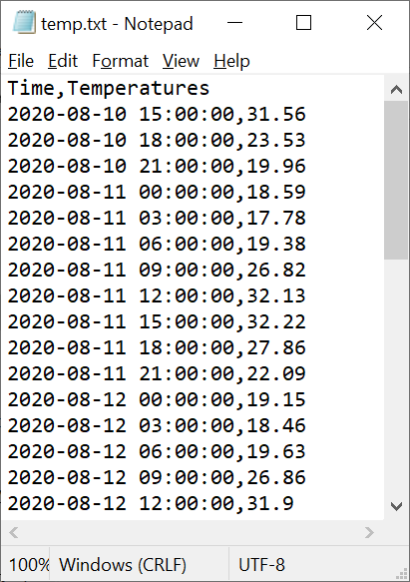
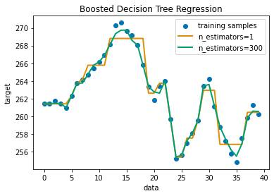
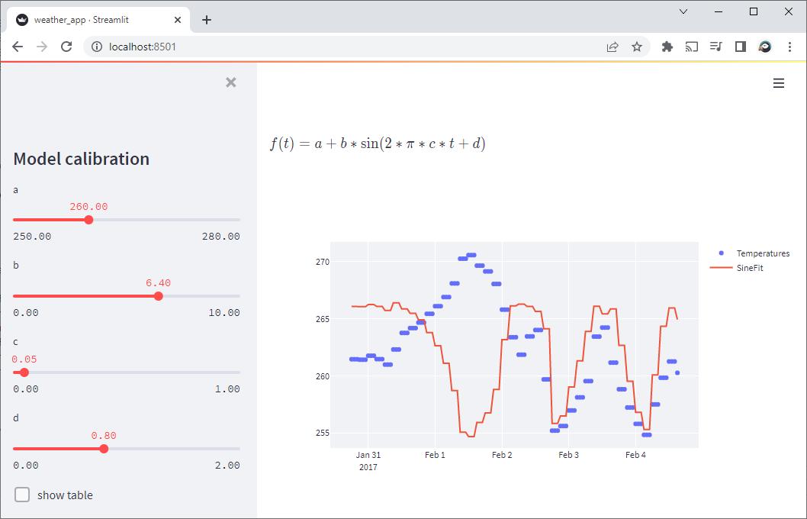
Weather.py build a scientific app with Python
Access Data (read file, request web service)
Develop Algo
Deploy App
Decision Tree Regression with AdaBoost — scikit-learn
Streamlit — Python-based data apps
Notes:
insidelabs-git.mathworks.com/ydebray/python-exercises

Slide 65
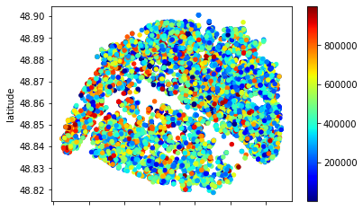
Immo.py
Call a function price, that will return the price of real estate in Paris as a dictionary
Get a list of location (lat,lon) and price
Select only the estate under 500k€
Write a file containing this data
(Bonus: plot the data on a map)

Slide 66

Immo.py
https://gist.github.com/slevin48/05c0d4f348f0f10870a0fa721cfcb1b1

Slide 67


Immo.py

Slide 68


Immo.py

Slide 69

Music.py
Parse Streaming History
Create a dictionary
id
artist name
track name
Music Taste Analysis
Get music features
Plot features
Get recommendation

Slide 70
Music for loop
with open("saved_tracks_20210306.json","r") as f:
results = json.load(f)
tracks = []
for idx, item in enumerate(results['items']):
track = item['track']
tracks.append([idx, track['artists'][0]['name'], track['name']])

Slide 71
Music Dict
trackDict = {"id":[], "artist":[],"name":[]}
for idx, item in enumerate(results['items']):
track = item['track']
trackDict["id"].append(idx)
trackDict["artist"].append(track['artists'][0]['name'])
trackDict["name"].append(track['name'])

Slide 72

Music taste analysis

Slide 73
Music taste analysis
import spotifyAPI
from secret import clientId,clientSecret token = spotifyAPI.get_token(clientId,clientSecret)
lucy_id = spotifyAPI.get_track_id2('Lucy in the Sky', token, artist = 'The Beatles’)
url = "https://open.spotify.com/track/"+lucy_id
import webbrowser
webbrowser.open(url)

Slide 74
import pandas as pd
lucy_features = spotifyAPI.get_features(lucy_id,token)
df = pd.DataFrame(lucy_features, index=[0])
df_features = df.loc[: ,['acousticness', 'danceability', 'energy', 'instrumentalness', 'liveness', 'speechiness', 'valence’]]
spotifyAPI.feature_plot(df_features)

Slide 75
Music recommendation
json_response = spotifyAPI.get_track_reco(lucy_id,token)
uris =[]
for i in json_response['tracks']:
uris.append(i)
print(f"\"{i['name']}\" by {i['artists'][0]['name']}")

Slide 76

Sources
Data Structures
Using Python to Access Web Data
Using Databases with Python
Capstone: Retrieving, Processing, and Visualizing Data with Python
PY4E - Python for Everybody
Python for Everybody (dr-chuck.com)

Slide 77

Go further
Crash Course on Python | Google
Using Python to Interact with the Operating System
Google IT Automation with Python
Configuration Management and the Cloud
Troubleshooting and Debugging Techniques
Introduction to Git and GitHub | Google
Automating Real-World Tasks with Python | Google

Slide 78





Data Science

Slide 79


Uninstall Python

Slide 80


Python.org console
Notes:
If you don’t want to install Python at all https://console.python.org/python-dot-org-console/

